Slide 1
The Flow of Power
Steven Low
Simons Institute: Real-time Decision Making Bookcamp
Power Systems, Berkeley, January 2018
Notes:
Simons Institute for the Theory of Computing, Berkeley
Program on Real-time Decision Making, Jan – May 2018
Organizers: Richard Karp (UCB, Chair), Josh Bloom (UCB), Steven Low (Caltech), Evdokia Nikolova (UTAustin), Balaji Prabhakar (Stanford)
Jan 25, 2018: Real-time Decision Marking Bootcamp: Energy Networks: The flow of Power, Berkeley (Karp)

Slide 2
Bootcamp: Power systems
The flow of power (S Low)
Basic concepts and models
Power flow and optimization
The flow of information (S Meyn)
Distributed control architectures
The flow of money (K Poolla)
Market structures and services
from steady state to dynamics
from engineering to economics

Slide 3
R. Karp’s instruction
“... the level should be sufficiently elementary that an expert on the topic will be bored.”

Slide 4
The flow of power I
Basic concepts and models
Why smart grid? (15 mins)
Three-phase AC transmission: 3 key ideas (30 mins)
Phasor representation
Balanced operation
Per-phase analysis
Device models (30 mins)
Transmission line
Transformer
Generator

Slide 5
The flow of power II
Power flow and optimization
Network models (10mins)
Admittance matrix
Power flow models
Optimal power flow problems (35mins)
Formulation and example
Convex relaxations
Real-time OPF

Slide 6
Why smart grid?

Slide 7
Watershed moment
Energy network will undergo similar architectural
transformation that phone network went through
in the last two decades to become the world’s
largest and most complex IoT
deregulation
started
IoT
Tesla: multi-phase AC
1888
both started as natural monopolies
both provided a single commodity
both grew rapidly through two WWs
1980-90s
1876
1980-90s
Bell: telephone
deregulation
started
convergence
to Internet
1969: DARPAnet

Slide 8
Watershed moment
Industries will be restructured
AT&T, MCI, McCaw Cellular, Qualcom
Google, Facebook, Twitter, Amazon, eBay, Netflix
Infrastructure will be reshaped
Centralized intelligence, vertically optimized
Distributed intelligence, layered architecture

Slide 9
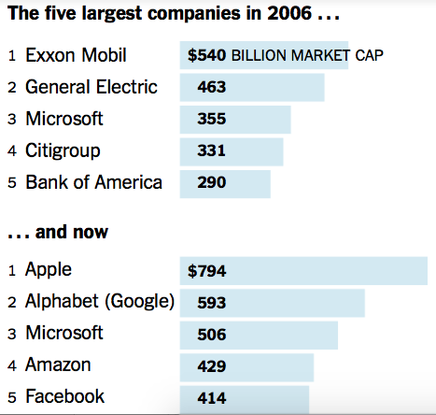
Watershed moment
(April 20, 2017)
What will drive power network transformation ?

Slide 10
Watershed moment
(April 20, 2017)
What will drive power network transformation ?

Slide 11
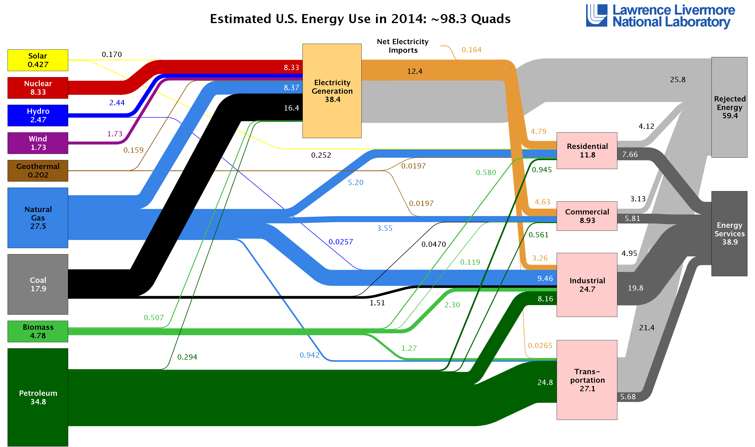
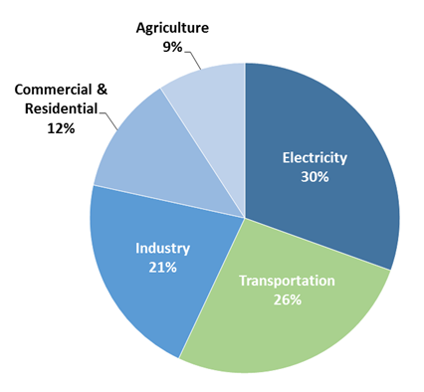
Electricity gen & transportation
Source:
USEPA
They consume the most energy
Consume 2/3 of all energy in US (2014)
They emit the most greenhouse gases
Emit >1/2 of all greenhouse gases in US (2014)
To drastically reduce greenhouse gases
Generate electricity from renewable sources
Electrify transportation
Notes:
Source: LLNL, https://flowcharts.llnl.gov/content/assets/images/charts/Energy/Energy_2015_United-States.png
Source: USEPA, https://www3.epa.gov/climatechange/ghgemissions/sources/transportation.html

Slide 12
World energy stats (2011)
Consumption | 519 quad BTU
petroleum | 34%
coal | 29%
gas | 23%
renewable (elec) | 8%
nuclear | 5%
Consumption | 519 (quad BTU) | per capita (mil BTU)
China | 20% | 78
US | 19% | 313
Russia | 6% | 209
India | 5% | 20
Japan | 4% | 164
total | 54%
top 5
countries
Source: EIA

Slide 13
World energy stats (2011)
Consumption | 519 quad BTU
petroleum | 34%
coal | 29%
gas | 23%
renewable (elec) | 8%
nuclear | 5%
Consumption | 519 (quad BTU) | CO2 emission
China | 20% | 27%
US | 19% | 17%
Russia | 6% | 5%
India | 5% | 5%
Japan | 4% | 4%
total | 54% | 58%
top 5
countries
Source: EIA

Slide 14
US greenhouse gas emission 2014
Electricity generation
and transportation are
top-two GHG emitters
(56% total)
… and they consume
the most energy
(66% total)
Total (2014) = 6,870 Million Metric Tons of CO2 equivalent
Source: USEPA, https://www3.epa.gov/climatechange/ghgemissions/sources/transportation.html

Slide 15
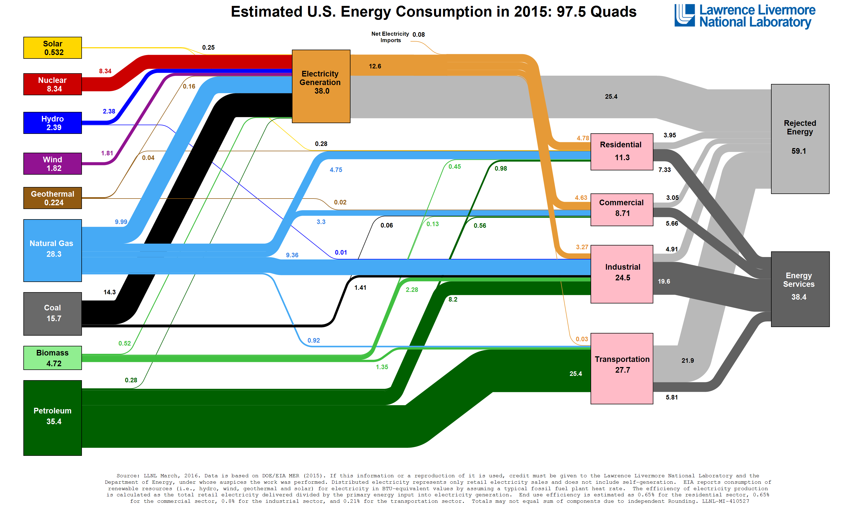
US energy flow 2015
Source: LLNL, https://flowcharts.llnl.gov/content/assets/images/charts/Energy/Energy_2015_United-States.png

Slide 16
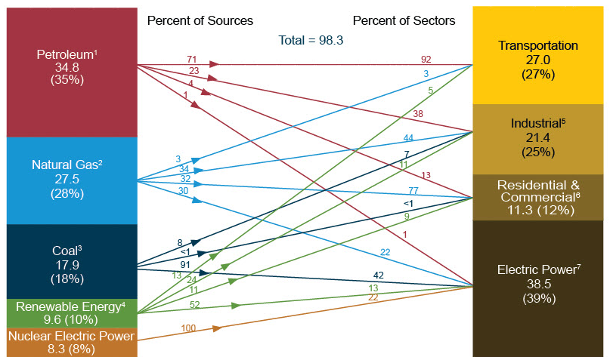
US energy flow 2014
quadrillion BTU
Source: EIA Monthly Energy Review March 2015

Slide 17
US electricity flow 2014
quadrillion Btu
Fossil : 65%
Conversion loss:
63%
Plant use: 2%
T&D losses: 2.4%
Nuclear: 21%
Gross gen:
37%
End use:
33%
Renewable: 13%
US total energy use: 98.3 quads
For electricity gen: 39%
Source: EIA March 2015
Monthly Energy Review

Slide 18
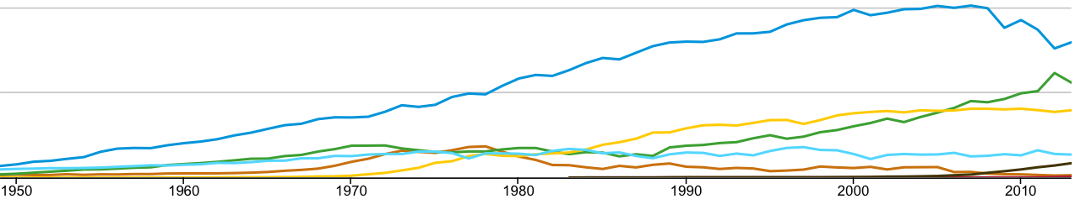
US dirty supply
2
trillion kWh
coal
gas
1
nuclear
hydro
oil
wind
solar
coal
all fossils
billion kWh
gas
nuclear
hydro
Source:
US EIA
Notes:
Coal consumption is decreasing while gas is going up. We can see from the monthly plots that they are almost crossing each other.
Nuclear generation has been relatively steady at around 20%
So is hydro at around 8% or so.
Wind is picking up in the last decade (2005-2015), but is still relatively small
Solar doesn’t even register at this scale. So let’s blow up the statistics on the renewables.

Slide 19
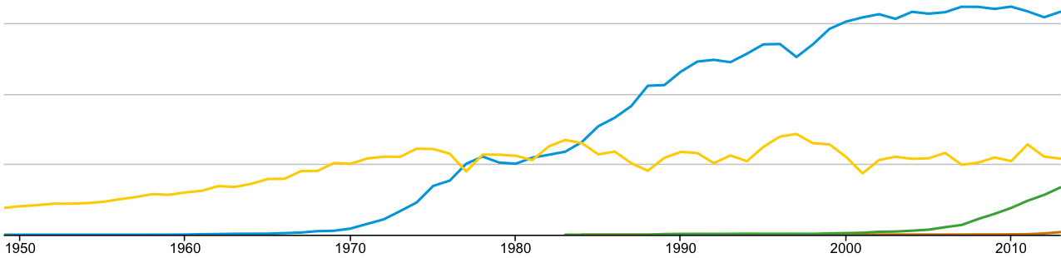
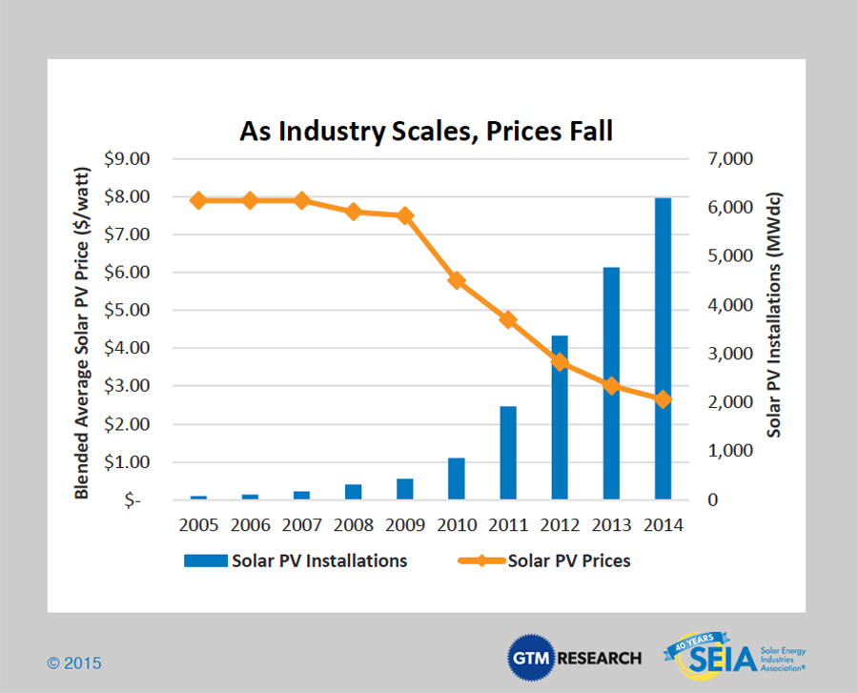
US renewable generations
750 billion kWh
nuclear
500
hydro
250
wind
solar
hydro
wind
solar
Source: US EIA
Notes:
Look at the monthly numbers, with hydro as the reference at about 8%.
Wind is approaching gas generation
Solar is picking up in the last couple years (2013-2015), but remains small.
Yet, the levelized cost of solar generation has been dropping dramatically in the last 5 years or so (2010 – 2015) as technologies advance and the industry scales. The cost is now under $3/watt and installed capacity by mid 2015 is close to 23 GW.
New startups with innovative business models have sprung up in the last couple years. In CA,

Slide 20
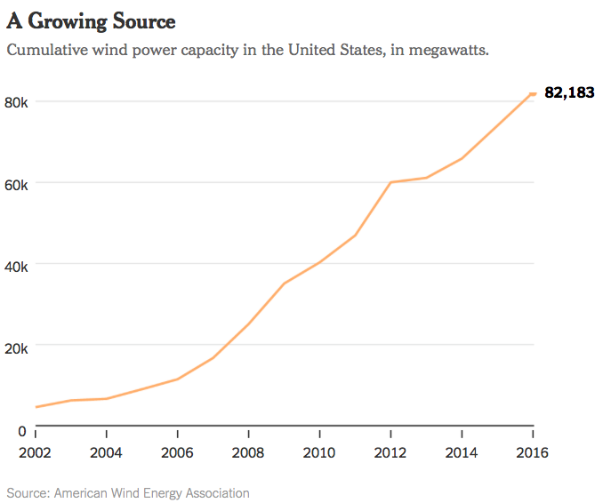
US wind capacity
Wind capacity (2016):
82,183 MW
Hydro capacity (2015):
78,956 MW
US wind generation capacity exceeded hydro capacity in 2016

Slide 21
US solar capacity
Federal
incentives
extended
to 2023
US solar industry snapshot
US installed solar capacity by mid 2015: ~23 GW
784K homes and businesses
Q2 2015 solar installation: 1.4 GW
Utility: 729 MW
Residential: 473 MW (70% growth yr-on-yr)
H1 2015: a new solar installation / 2 mins
Source: SEIA 2015
(Solar Energy Industries Association)

Slide 22
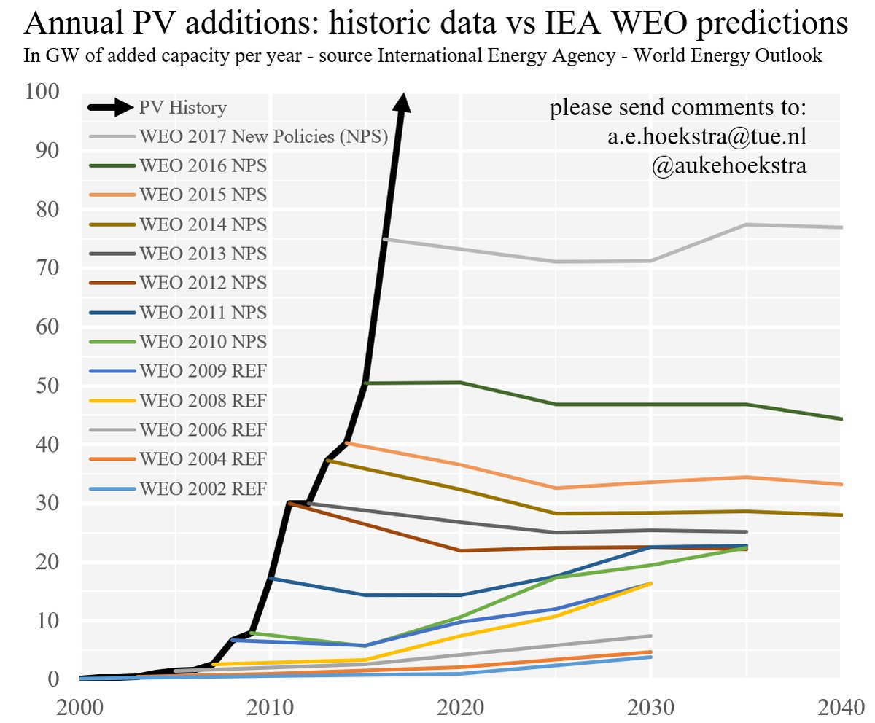

Slide 23
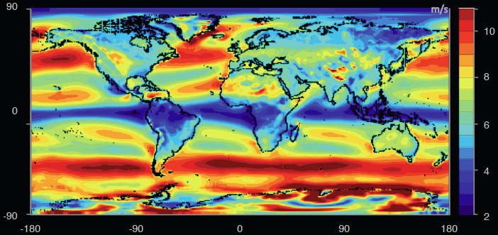
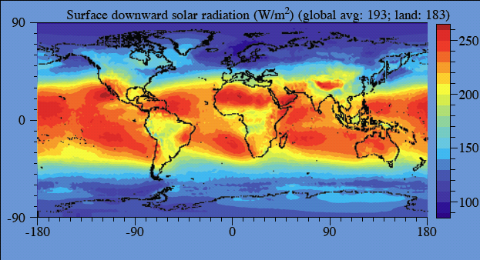
Worldwide
energy demand:
16 TW
electricity demand:
2.2 TW
Wind power over land (exc. Antartica)
70 – 170 TW
Source: Renewable Energy
Global Status Report, 2010
Source: M. Jacobson, 2011
Solar power over land
340 TW
Notes:
World wind speed at 100m:
All wind worldwide: 1,700 TW
All wind over land in high-wind areas outside Antartica: 70 – 170 TW
World power (all energy) demand in 2030: 16.9 TW
World surface solar
All solar worldwide: 6,500 TW
All solar over land in high-solar locations: 340 TW
Source: Renewable Energy Global Status Report, Sept 2010:
2009 grid-tied solar PV capacity increase
The world added 7GW of grid-connected PV capacity, to a total of 21 GW
Germany: +3.8 GW to a total of 9.8 GW
Spain: +70MW to a total of 3.4 GW (Govt subsidy expired!)
US: +470MW to a total of 1 GW (CA ~half of increase)
Off-grid capacity: 4 GW
2009 wind capacity increase
Wind power increased the most among all renewables, by 38 GW to a total of 159 GW
US: +10 GW to a total of 35 GW
China: +13.8 GW to a total of 25.8 GW
Germany: +1.9GW to a total of 25.8 GW

Slide 24

Power the world by solar
Notes:
World wind speed at 100m:
All wind worldwide: 1,700 TW
All wind over land in high-wind areas outside Antartica: 70 – 170 TW
World power (all energy) demand in 2030: 16.9 TW
World surface solar
All solar worldwide: 6,500 TW
All solar over land in high-solar locations: 340 TW
Source: Renewable Energy Global Status Report, Sept 2010:
2009 grid-tied solar PV capacity increase
The world added 7GW of grid-connected PV capacity, to a total of 21 GW
Germany: +3.8 GW to a total of 9.8 GW
Spain: +70MW to a total of 3.4 GW (Govt subsidy expired!)
US: +470MW to a total of 1 GW (CA ~half of increase)
Off-grid capacity: 4 GW
2009 wind capacity increase
Wind power increased the most among all renewables, by 38 GW to a total of 159 GW
US: +10 GW to a total of 35 GW
China: +13.8 GW to a total of 25.8 GW
Germany: +1.9GW to a total of 25.8 GW

Slide 25
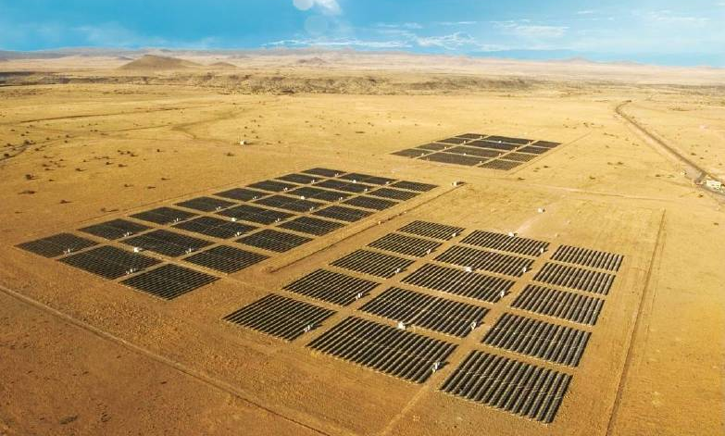
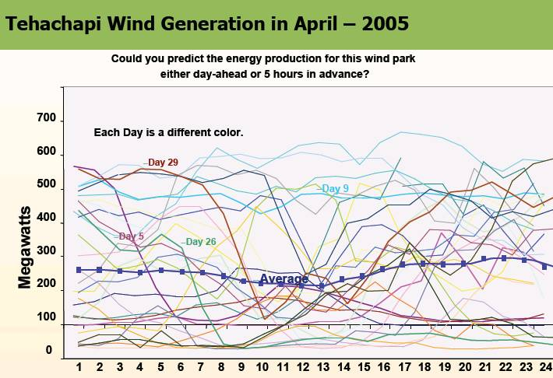
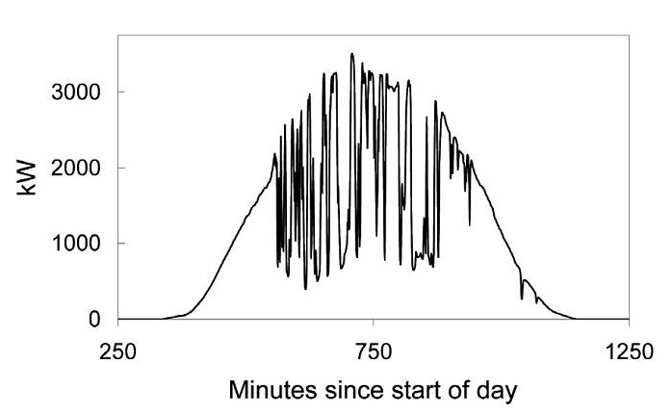
Uncertainty
High Levels of Wind and Solar PV Will Present an Operating Challenge!
Source: Rosa Yang, EPRI

Slide 26
Voltage violations are quite frequent
Source: Leon Roose, University of Hawaii
Development & demo of smart grid inverters for high-penetration PV applications

Slide 27
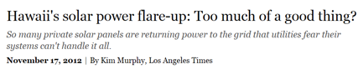

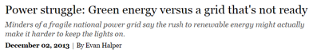


“Energiewende”
Source: Leon Roose, University of Hawaii
Development & demo of smart grid inverters for high-penetration PV applications

Slide 28
Today’s grid
Few large generators
~10K bulk generators (>90% capacity), actively controlled
Many dump loads
131M customers, 3,100 utilities, ~billion passive loads
Control paradigm: schedule supply to match demand
Centralized, human-in-the-loop, worst case, deterministic

Slide 29
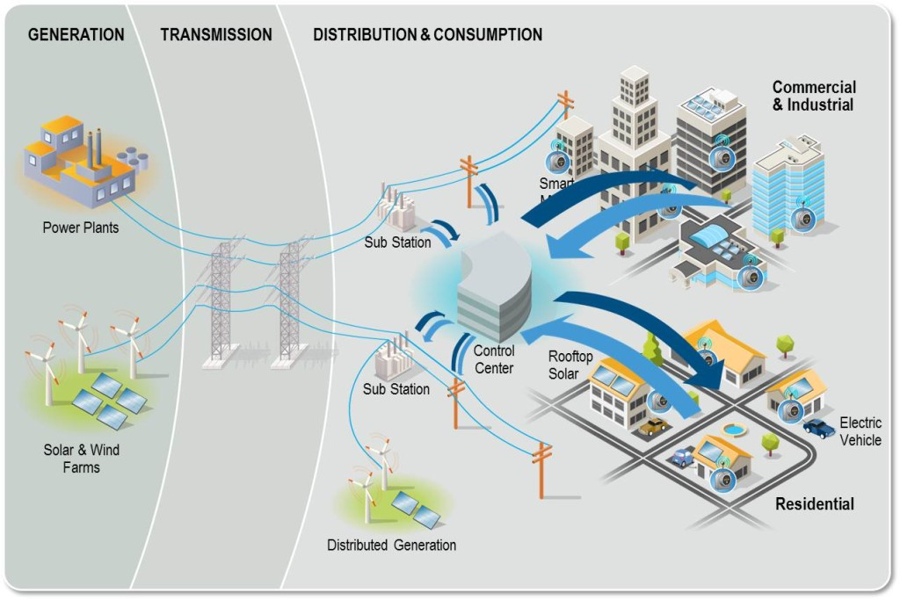
Future grid
Wind and solar farms are not dispatchable
Many small distributed generations
Network of distributed energy resources (DERs)
EVs, smart buildings/appliances/inverters, wind turbines, storage
Control paradigm: match demand to volatile supply
Distributed, real-time feedback, risk limiting, robust

Slide 30
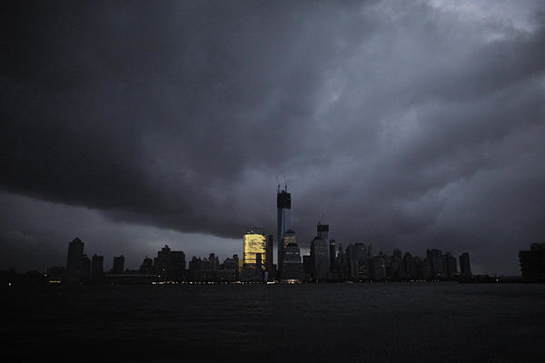
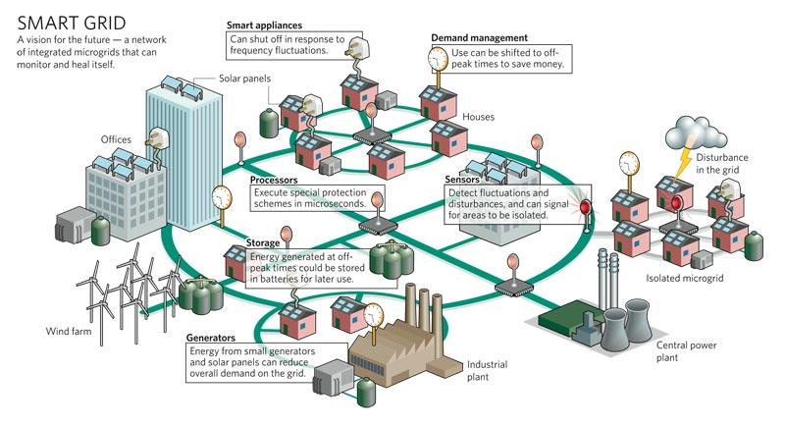
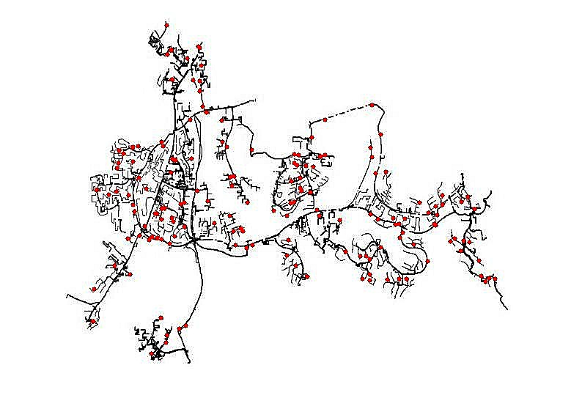
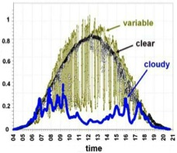








Risk: active DERs introduce rapid random
fluctuations in supply, demand, power quality
increasing risk of blackouts
Opportunity: active DERs enables realtime
dynamic network-wide feedback control,
improving robustness, security, efficiency
Caltech research: distributed control of networked DERs
Foundational theory, practical algorithms, concrete
applications
Integrate engineering and economics
Active collaboration with industry

Slide 31
Implication of active DER
Current control paradigm works well today
Centralized, open-loop, human-in-loop, worst-case preventive
Low uncertainty, few active assets to control
Schedule supplies to match loads
Future needs
Closing the loop, e.g. real-time DR, volt/var
Fast computation to cope with rapid, random, large fluctuations in supply, demand, voltage, freq
Simple algorithms to scale to large networks of active DER
Market mechanisms to incentivize

Slide 32
Recap
Global energy demand will continue to grow
There is more renewable energy than the world ever needs
Someone will figure out how to capture and store it
There will be connected intelligence everywhere
Cost of computing, storage, communication and manufacturing will continue to drop
Power system will transform into the largest and most complex Internet of Things
Generation, transmission, distribution, consumption, storage

Slide 33
Recap
To develop technologies that will enable and guide the historic transformation of our power system
Materials, devices, systems, theory, algorithms
Control, optimization, stochastics, data, economics

Slide 34
Motivation: Optimal power flow
gen cost, power loss
power flow equation
line flow
injection limits
line limits
voltage limits
describes network topology and impedances
is net power injection (generation) at node j

Slide 35
The flow of power I
Basic concepts and models
Why smart grid? (15 mins)
Three-phase AC transmission: 3 key ideas (30 mins)
Phasor representation
Balanced operation
Per-phase analysis
Device models (30 mins)
Transmission line
Transformer
Generator

Slide 36
Visualizing the grid

Slide 37
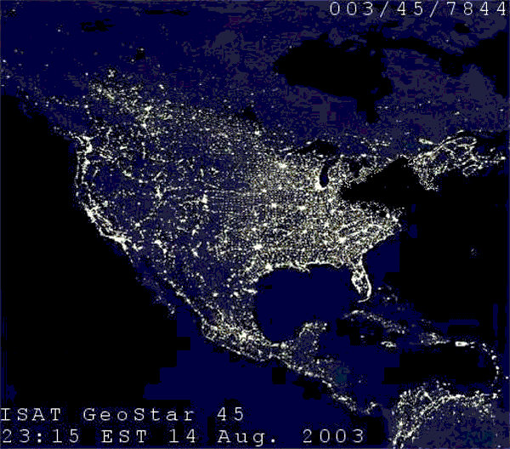

Slide 38
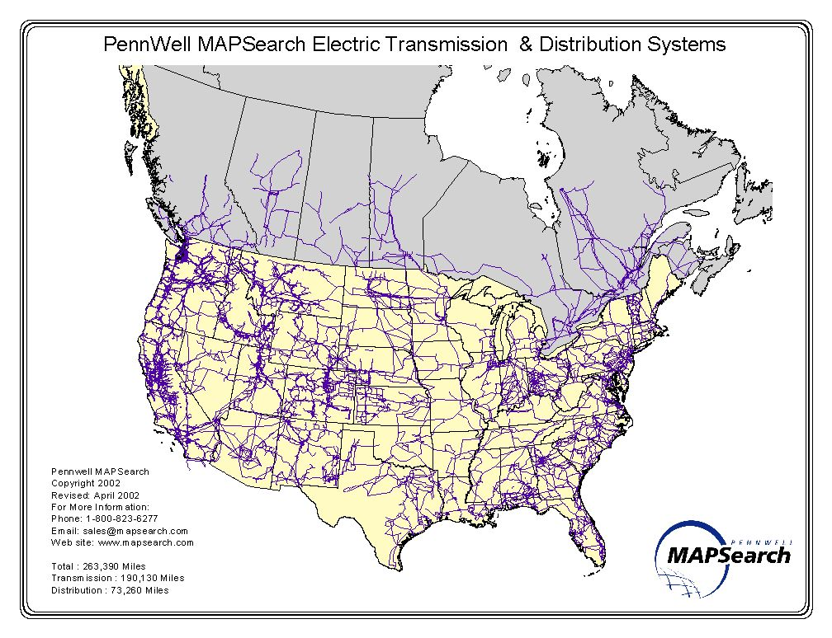
Transmission lines: 190K miles
Distribution lines: 73K miles
(2002)
[Sascha von Meier]

Slide 39
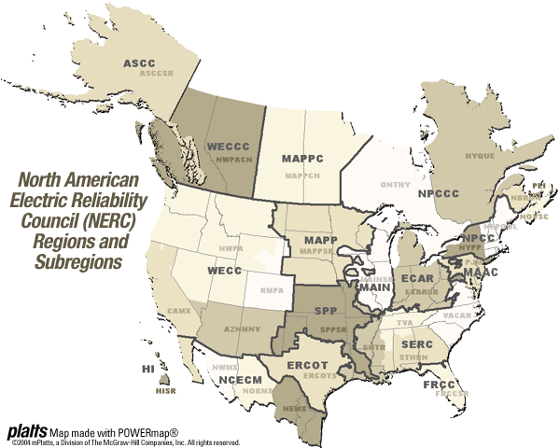
[Sascha von Meier]

Slide 40
Today’s grid
Few large generators
~10K bulk generators (>90% capacity), actively controlled
Many dump loads
131M customers, 3,100 utilities, ~billion passive loads
Control paradigm: schedule supply to match demand
Centralized, human-in-the-loop, worst case, deterministic

Slide 41
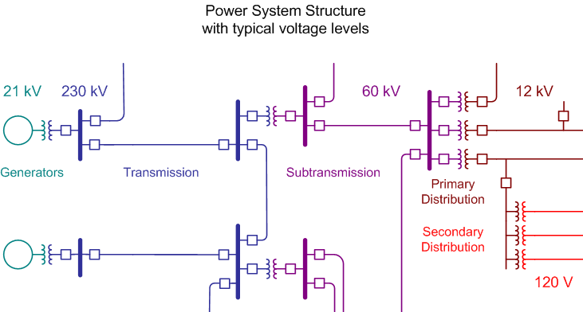
[Sascha von Meier]
Notes:
41

Slide 42
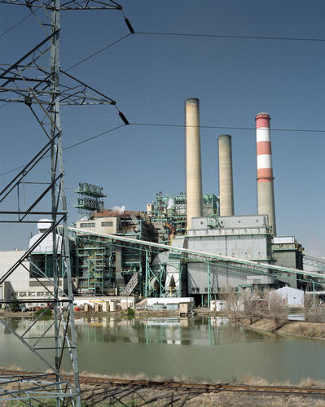
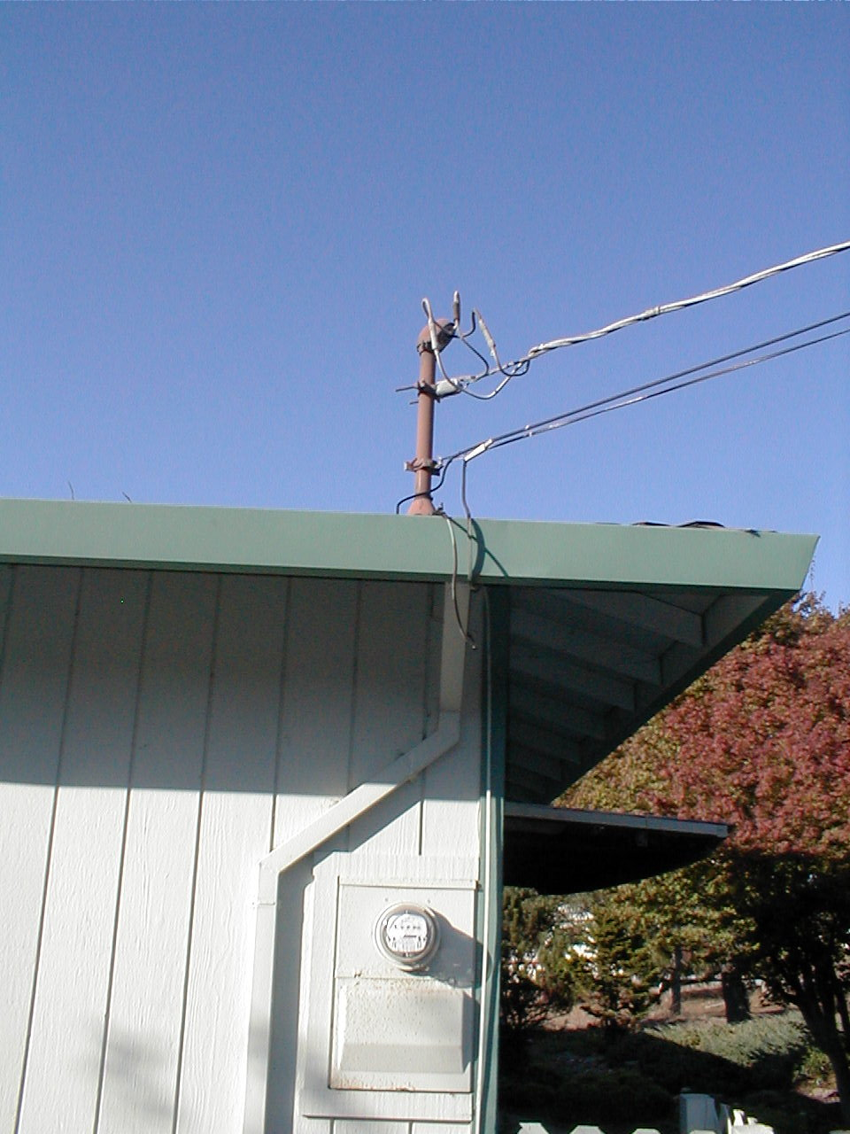
[Sascha von Meier]
service drop
Notes:
42

Slide 43
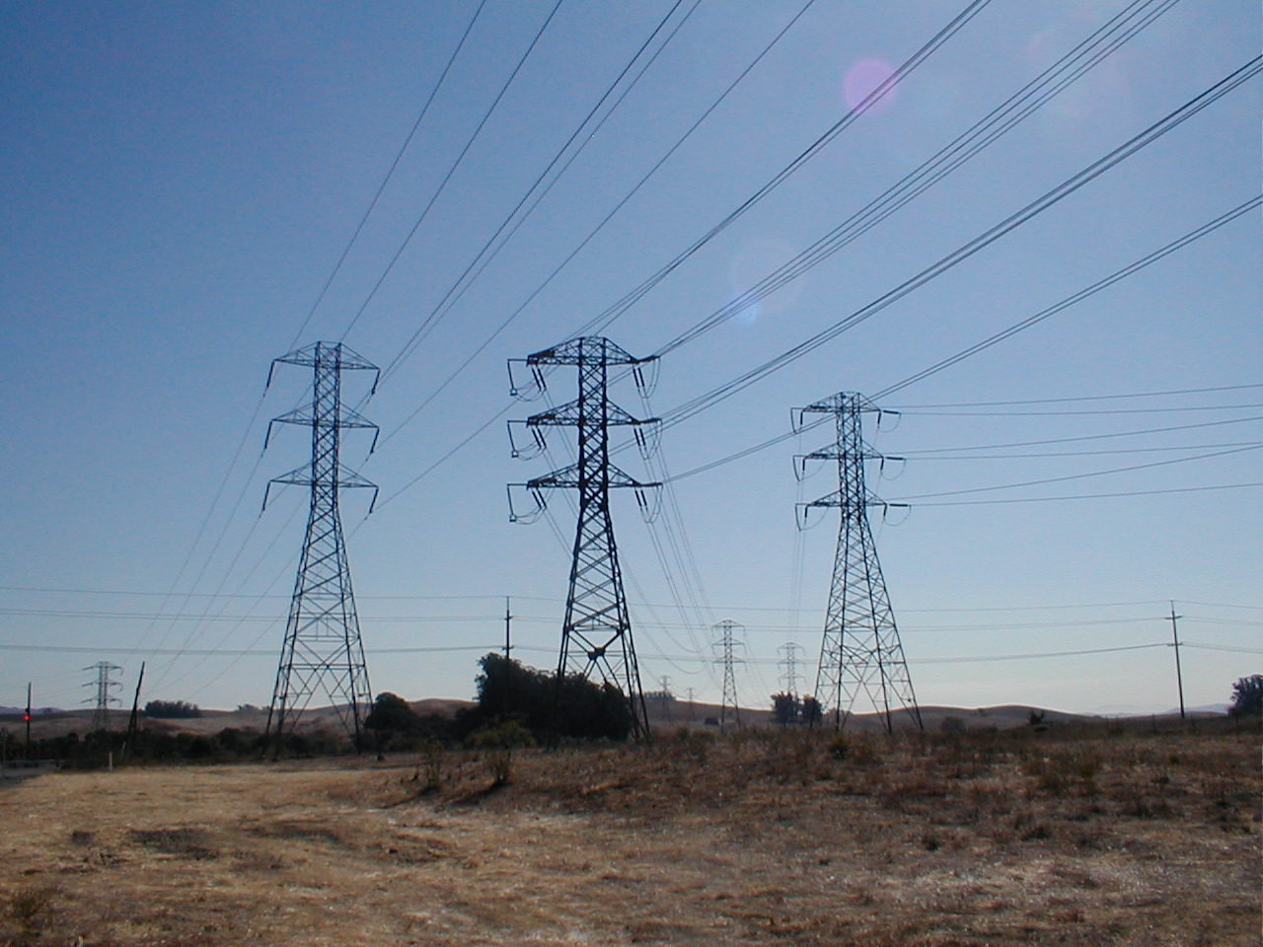
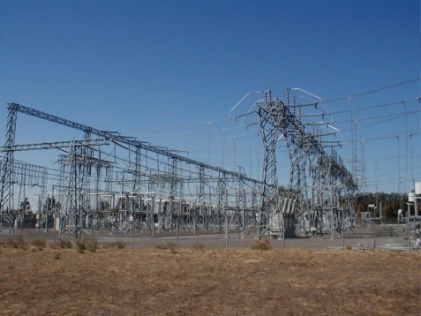
transmission
line
transmission
substation
[Sascha von Meier]
Notes:
43

Slide 44
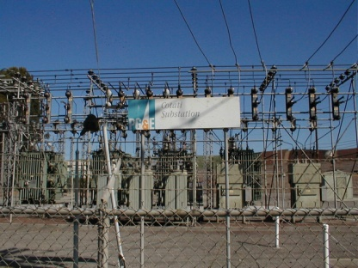
distribution
substation
[Sascha von Meier]
Notes:
44

Slide 45
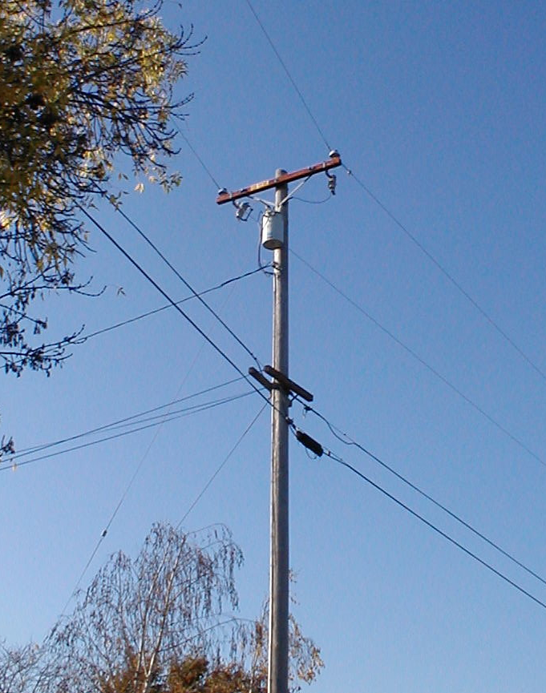
transformer &
distribution line
[Sascha von Meier]
Notes:
45

Slide 46
[Sascha von Meier]
service drop
Notes:
46

Slide 47
Mathematical model
Quantities of interest
Voltage, current, power, energy
All are sinusoidal functions of time
Voltage
Steady state: frequencies at all points are nominal
Reasonable model at timescale of minute and up
nominal frequency
US: 60 Hz
EU: 50 Hz

Slide 48
Mathematical model
Quantities of interest
Voltage, current, power, energy
All are sinusoidal functions of time
Voltage
Steady state: frequencies at all points are nominal
Reasonable model at timescales of minute and up
Dynamic models at sec-min timescale: S Meyn’s tutorial
nominal frequency
North/Central Americas: 60 Hz
Most other major countries: 50 Hz
this part of tutorial is all about steady state

Slide 49
Phasor representation
Quantities of interest
Voltage, current, power, energy
All are sinusoidal functions of time
Voltage
amplitude
phase
voltage
phasor

Slide 50
Phasor representation
Quantities of interest
Voltage, current, power, energy
All are sinusoidal functions of time
Voltage
voltage
phasor

Slide 51
Phasor representation
Quantities of interest
Voltage, current, power, energy
All are sinusoidal functions of time
Voltage
voltage
phasor

Slide 52
Phasor representation
Voltage
Current

Slide 53
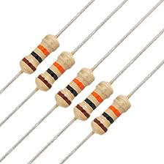
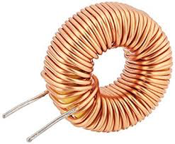
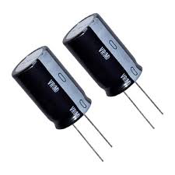
Linear circuit elements
Resistor R
Inductor L
Capacitor C
these are main circuit elements to model the grid

Slide 54
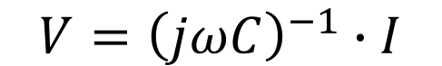
Linear circuit elements
Resistor R
Inductor L
Capacitor C
$$V={\left(jωC\right)}^{−1}∙I$$

Slide 55
Linear circuit elements
time
domain
phasor
domain

Slide 56
Complex power
Quantities of interest
Voltage, current, power, energy
All are sinusoidal functions of time
Instantaneous power
average power

Slide 57
Complex power
Quantities of interest
Voltage, current, power, energy
All are sinusoidal functions of time
Instantaneous power
Complex power
average power
real (active) power
reactive power

Slide 58
Phasor analysis
Steady state behavior described by algebraic equations
Instead of dynamic equations
Circuit analysis
Voltages and currents are linear
Power flow analysis
Power flow equations are nonlinear
We will describe device and network models, and analyze
them, in phasor domain

Slide 59
3-phase AC : 3 key ideas
Phasor representation
Balanced operation
Per-phase analysis

Slide 60
3-phase AC system
3 single-phase system:
single 3-phase system:

Slide 61
3-phase AC system
Y-configuration:
voltage source
impedance load
Delta-configuration:

Slide 62
3-phase AC system
Y-configuration:
voltage source
impedance load
Balanced 3p source
Equal in magnitude, 120 deg difference in phase
Balanced 3p impedance load
Identical impedances

Slide 63
3-phase AC system
Balanced 3p source
Equal in magnitude, 120 deg difference in phase
Balanced 3p impedance load
Identical impedances
voltage source
impedance load
Delta-configuration:

Slide 64
Balanced 3-phase system
transmission line
voltage
source
impedance
load
Balanced 3p operation
Balanced 3p sources
Balanced 3p loads
Balanced (identical) transmission lines

Slide 65
Advantages
1-phase
3-phase

Slide 66
Advantages
1-phase
3-phase

Slide 67
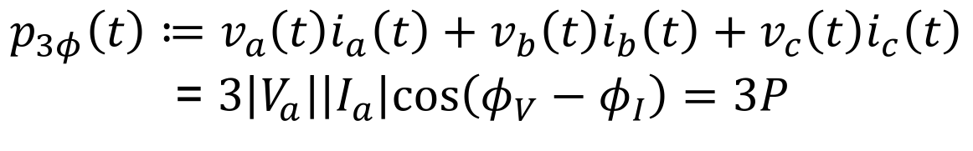
Advantages
1-phase
3-phase
$$p_{3φ}\left(t\right)≔v_{a}\left(t\right)i_{a}\left(t\right)+v_{b}\left(t\right)i_{b}\left(t\right)+v_{c}\left(t\right)i_{c}\left(t\right)$$
= $3\left|V_{a}\right|\left|I_{a}\right|cos\left(φ_{V}−φ_{I}\right)=3P$
Advantages of balanced 3p operation
Instantaneous power is constant in t !
Uses ~1/2 as much materials (wires) as three 1p system
Incurs ~1/2 as much active power loss as three 1p system

Slide 68
3-phase AC : 3 key ideas
Phasor representation
Balanced operation
Per-phase analysis

Slide 69
Per-phase analysis: Wye
Important properties of balanced 3p system

Slide 70
Per-phase analysis: Wye
Important properties of balanced 3p system
All voltages and currents are 3-phase balanced
Phases are decoupled, i.e., variables in each phase depend only on quantities in that phase

Slide 71
Per-phase analysis: Wye
Properties:
All voltages and currents are 3-phased balanced
Phases are decoupled
per-phase equivalent circuit
...
...

Slide 72
Delta-Wye transformation
Equivalent 3p sources: same external behavior
line-to-line voltages:

Slide 73
Delta-Wye transformation
Equivalent 3p sources: same external behavior
line-to-line voltages:

Slide 74
Delta-Wye transformation
Equivalent 3p sources: same external behavior
same terminal currents on same line-to-line voltages

Slide 75
Per-phase analysis
transmission line
voltage
source
impedance
load
Convert all Delta sources and loads into Wye
Solve phase a circuit with all neutrals connected for desired variables
Phase b / c variables: subtract / add 120deg to phase a variables
If variables internal to Delta configurations are desired, solve them from original circuit

Slide 76
Per-phase analysis
transmission line
voltage
source
impedance
load
phase-a
circuit

Slide 77
Per-phase analysis
transmission line
voltage
source
impedance
load
phase-a
circuit

Slide 78
Recap: basic concepts
3-phase AC transmission system
Phasor representation
Balanced operation
Per-phase analysis
We will describe device and network models, and analyze
them, in phasor domain, using per-phase analysis

Slide 79
The flow of power I
Basic concepts and models
Why smart grid? (15 mins)
Three-phase AC transmission: 3 key ideas (30 mins)
Phasor representation
Balanced operation
Per-phase analysis
Device models (30 mins)
Transmission line
Transformer
Generator

Slide 80
Transmission line model
model of transmission line
Terminal behavior
What do line parameters depend on ?
What about a 3-phase line ?
What are some implications ?
series impedance
shunt
admittance

Slide 81
Transmission line model
Line inductance l
Multiple conductors
total flux linkages
self inductance
mutual inductance

Slide 82
Transmission line model
Conditions
Symmetric 3-phase line
Multiple conductors
“self-inductance”
The phases are decoupled !

Slide 83
Transmission line model
Line capacitance c
Multiple conductors
total charge / m
self inductance
mutual inductance

Slide 84
Transmission line model
Conditions
Symmetric 3-phase line
Multiple conductors
“self-capacitance”
The phases are decoupled !

Slide 85
Transmission line model
Line parameters (balanced 3p line)
Phases are decoupled
Line inductance and capacitance
Line resistance r / conductance g depend on wire material & size

Slide 86
Transmission line model
per-phase model of phase voltage:

Slide 87
Transmission line model
per-phase model of phase voltage:

Slide 88
Transmission line model
model of transmission line
series impedance
shunt
admittance

Slide 89
Transmission line model
Long line (l>150mi):
Long line (50<l<150mi):
Long line (l<50mi):

Slide 90
Transmission line model
High voltage min transmission line loss
Specified: required load power and voltage

Slide 91
Transmission line model
Recap
Line characteristics depend on materials, size, and geometry of 3-phase line
Linear per-phase circuit model
circuit model: series impedance + shunt admittance

Slide 92
The flow of power I
Basic concepts and models
Why smart grid? (15 mins)
Three-phase AC transmission: 3 key ideas (30 mins)
Phasor representation
Balanced operation
Per-phase analysis
Device models (30 mins)
Transmission line
Transformer
Generator

Slide 93
Transformer model
Single-phase ideal transformer n

Slide 94
Transformer model
Single-phase (non-ideal) transformer
can be easily measured

Slide 95
Transformer model
Single-phase (non-ideal) transformer

Slide 96
Transformer model
3-phase ideal transformer

Slide 97
Transformer model
3-phase ideal transformer
per-phase properties

Slide 98
Transformer model
3-phase ideal transformer
per-phase properties

Slide 99
Transformer model
3-phase ideal transformer
per-phase properties

Slide 100
Transformer model
3-phase ideal transformer
per-phase properties

Slide 101
Transformer model
Per-phase equivalent circuit

Slide 102
Transformer model
Recap
Four configurations: YY, DD, DY, YD
Linear per-phase circuit model

Slide 103
Generator model

Slide 104
Putting everything together
3p generator
(terminal
voltage)
3p transformer
(stepup)
3p transmission
line
3p transformer
(stepdown)

Slide 105
Putting everything together
single-phase equivalent circuit

Slide 106
The flow of power II
Power flow and optimization
Network models (10mins)
Admittance matrix
Power flow models
Optimal power flow problems (35mins)
Formulation and example
Convex relaxations
Real-time OPF

Slide 107
Example circuit model

Slide 108
Network model
Each line modeled as model
Series impedance
Shunt admittance at each end
They may not be equal

Slide 109
Network admittance matrix
Y : network graph + admittances

Slide 110
Network admittance matrix

Slide 111
The flow of power II
Power flow and optimization
Network models (10mins)
Admittance matrix
Power flow models
Optimal power flow problems (35mins)
Formulation and example
Convex relaxations
Real-time OPF

Slide 112
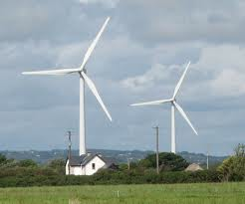

Bus injection model
i
j
k
admittance matrix:
graph G: undirected
Y specifies topology of G and
impedances z on lines

Slide 113
Bus injection model
Kirchhoff law
power balance
admittance matrix:

Slide 114
Bus injection model
Kirchhoff law
power balance
Eliminate I :

Slide 115
Bus injection model
Complex form:
Polar form:
Cartesian form:

Slide 116
Bus injection model
DC power flow
Assumptions:
Lossless short line
Small angle difference
Fixed voltage magnitude
Ignore reactive power

Slide 117
Branch flow model
Kirchhoff law
power definition
power balance
sending
end pwr
loss
sending
end pwr

Slide 118
Recap
Bus injection model
Branch flow model
solution
set

Slide 119
Equivalence
Theorem:
BIM and BFM are equivalent in this sense
Any result in one model is in principle provable in the other,
… but some results are easier to formulate or prove in one
than the other
solution
set

Slide 120
BFM for radial networks
Reduces to DistFlow model of Baran-Wu 1989
Efficient solution: forward-backward sweep
Linear model more suitable for distribution system
Explicit solution for linear model
Simple analytical bounds on nonlinear DistFlow model
Extension to multiphase unbalanced model
Much more numerically stable

Slide 121
The flow of power II
Power flow and optimization
Network models (10mins)
Admittance matrix
Power flow models
Optimal power flow problems (35mins)
Formulation and example
Convex relaxations
Real-time OPF

Slide 122
Optimal power flow (OPF)
OPF is solved routinely for
network control & optimization decisions
market operations & pricing
at timescales of mins, hours, days, …
Non-convex and hard to solve
Huge literature since 1962
Common practice: DC power flow (LP)
Also: Newton-Raphson, interior point, …

Slide 123
Optimal power flow
gen cost, power loss
power flow equation
line flow
injection limits
line limits
voltage limits
describes network topology and impedances
is net power injection (generation) at node j

Slide 124
Optimal power flow
gen cost, power loss
power flow equation
line flow
injection limits
line limits
voltage limits
nonconvex feasible set (nonconvex QCQP)
not Hermitian (nor positive semidefinite)
is positive semidefinite (and Hermitian)

Slide 125
Optimal power flow
OPF problem underlies numerous applications
nonlinearity of power flow equations ➔ nonconvexity
Ian Hiskens, Michigan

Slide 126
Dealing with nonconvexity
Linearization
DC approximation
Convex relaxations
Semidefinite relaxation (Lasserre hierarchy)
QC relaxation (van Hentenryck)
Strong SOCP (Sun)

Slide 127
Dealing with nonconvexity
Linearization
DC approximation
Convex relaxations
Semidefinite relaxation (Lasserre hierarchy)
QC relaxation (van Hentenryck)
Strong SOCP (Sun)
Realtime OPF
Online algorithm, as opposed to offline
Also tracks time-varying OPF

Slide 128
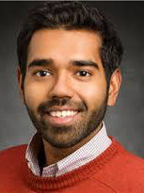



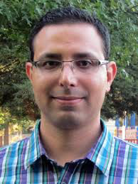
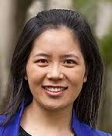
Relaxations of AC OPF
dealing with nonconvexity
Bose (UIUC)
Chandy
Farivar (Google)
Gan (FB)
Lavaei (UCB)
Li (Harvard)
many others at & outside Caltech …
Low, Convex relaxation of OPF, 2014
http://netlab.caltech.edu

Slide 129
Equivalent feasible sets
quadratic in V
linear in W
Equivalent problem:
convex in W
except this constraint

Slide 130
Solution strategy
If optimal solution satisfies easily checkable conditions, then optimal solution of OPF can be recovered

Slide 131
Equivalent relaxations
Theorem
Radial G: SOCP is equivalent to SDP ( )
Mesh G: SOCP is strictly coarser than SDP
For radial networks: always solve SOCP !

Slide 132
Exact relaxation
For radial networks, sufficient conditions on
power injections bounds, or
voltage upper bounds, or
phase angle bounds

Slide 133
Exact relaxation
For radial networks, sufficient conditions on
power injections bounds, or
voltage upper bounds, or
phase angle bounds

Slide 134
Exact relaxation
QCQP
graph of QCQP
QCQP over tree

Slide 135
Exact relaxation
QCQP
Key condition
Theorem
SOCP relaxation is exact for
QCQP over tree
Bose et al 2012, 2014
Sojoudi, Lavaei 2013

Slide 136
Implication on OPF
Not both lower & upper bounds on real & reactive powers at both ends
of a line can be finite

Slide 137
Example
Real Power
Reactive Power
SOCP Y
SDP Y
power flow
solution X
Relaxation is exact if X and Y have same Pareto front
SOCP is faster but coarser than SDP
Bose, Low, Teeraratkul, Hassibi TAC 2015

Slide 138
Potential benefits
IEEE test
systems
SDP
cost
MATPOWER cost
12.4% lower cost than solution from nonlinear solver MATPOWER
[Louca, Seiler, Bitar 2013]

Slide 139
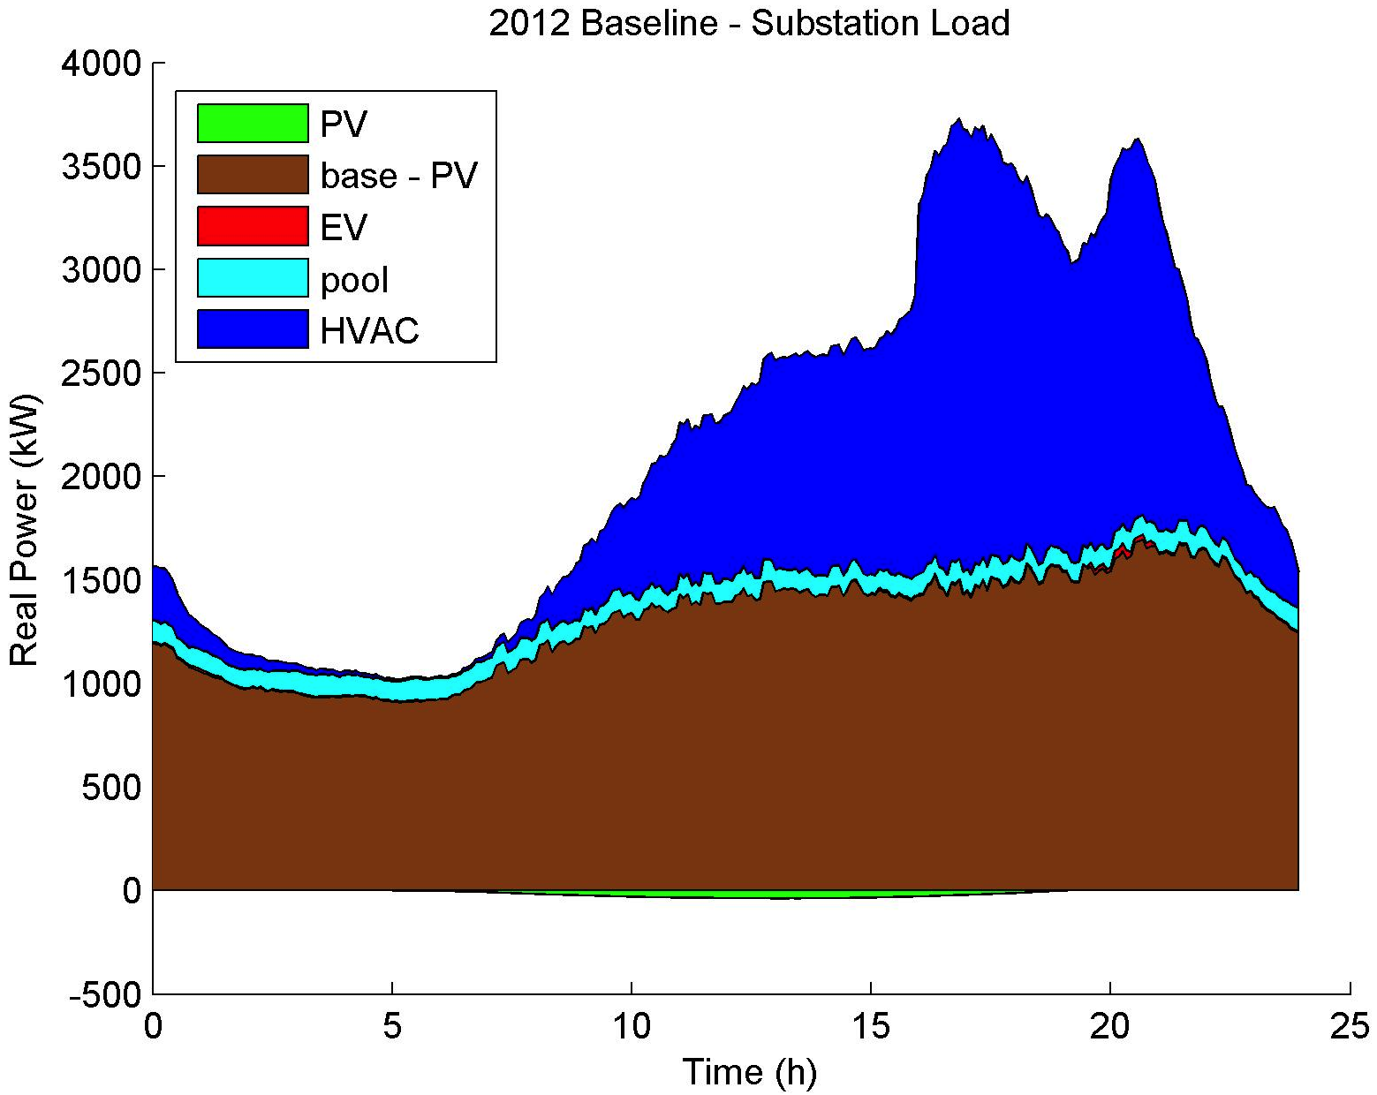
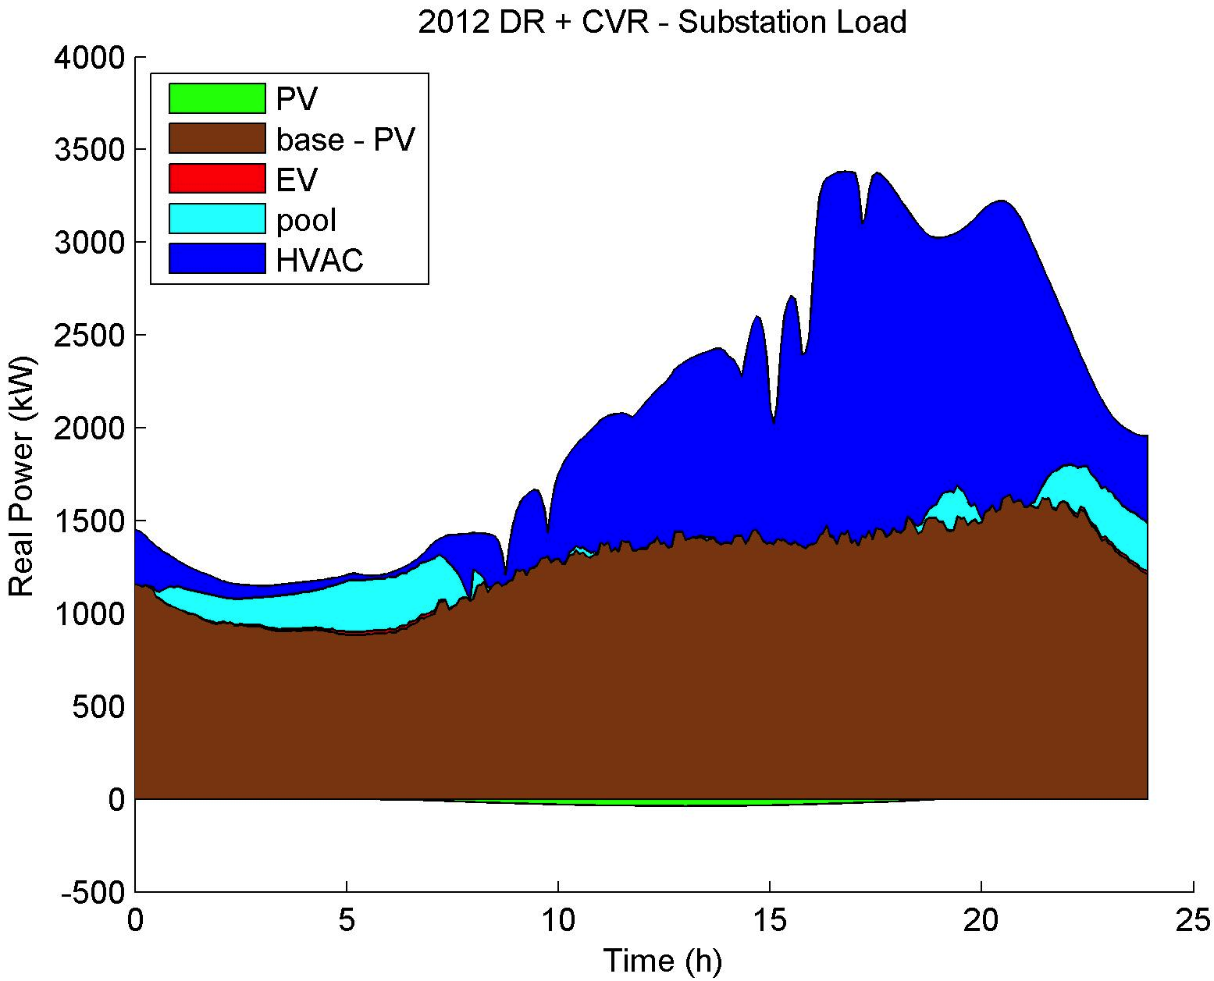
Potential benefits
Case study on an SCE feeder
Southern California
1,400 residential houses, ~200 commercial buildings
Controllable loads: EV, pool pumps, HVAC, PV inverters
Formulated as an OPF problem, multiphase unbalanced radial network
baseline
optimized
peak load reduction: 8%
energy cost reduction: 4%

Slide 140
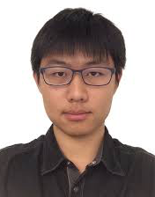
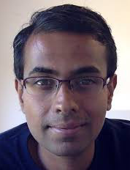
Realtime AC OPF
for tracking
Gan (FB)
Tang (Caltech)
Dvijotham (DeepMind)
See also: Dall’Anese et al, Bernstein et al,
Hug & Dorfler et al, Callaway et al
Gan & L, JSAC 2016
Tang et al, TSG 2017

Slide 141
Motivations
Simplify OPF simulation/solution
Solving static OPF with simulator in the loop
Avoid modifying GridLab-D during ARPA-E GENI (2012-15)
Deal with nonconvexity
Network computes power flow solutions in real time at scale for free
Exploit it for our optimization/control
Track optimal solution of time-varying OPF
Uncertainty will continue to increase
Real-time measurements increasingly become available on seconds timescale
Must, and can, close the loop in the future

Slide 142
Dealing with nonconvexity
Linearization
DC approximation
Convex relaxations
Semidefinite relaxation (Lasserre hierarchy)
QC relaxation (van Hentenryck)
Strong SOCP (Sun)
Realtime OPF
Online algorithm, as opposed to offline
Also tracks time-varying OPF

Slide 143
Literature
Static OPF:
Gan and Low, JSAC 2016
Dall’Anese, Dhople and Giannakis, TPS 2016
Arnold et al, TPS 2016
A. Hauswirth, et al, Allerton 2016
Time-varying OPF:
Dall’Anese and Simonetto, TSG 2016
Wang et al, TPS 2016
Tang, Dvijotham and Low, TSG 2017
Tang and Low, CDC 2017
Earlier relevant work on voltage control
Survey: Molzahn et al, TSG 2017

Slide 144
OPF
power flow equations
operational constraints
controllable
devices
uncontrollable
state
capacity limits

Slide 145
OPF
power flow equations
operational constraints
capacity limits

Slide 146
OPF
power flow equations
operational constraints
capacity limits

Slide 147
OPF: eliminate y
Theorem [Huang, Wu, Wang, & Zhao. TPS 2016]
For DistFlow model, controllable (feasible) region
is convex (despite nonlinearity of y(x))

Slide 148
OPF: add barrier or penalty
add barrier or penalty function
to remove operational constraints
f: nonconvex

Slide 149
Online (feedback) perspective
cyber
network
measurement,
communication
y(t)
control
x(t)
physical
network
Explicitly exploits network as power flow solver
Naturally tracks changing network conditions

Slide 150
physical
network
measurement
x(t)
control
u(t)
cyber
network

Slide 151

Outline: realtime OPF
Motivation
Problem formulation
Static OPF
1st order algorithm
Optimality properties
Time-varying OPF
2nd order algorithm
Tracking performance
Distributed implementation
[Gan & Low, JSAC 2016]
[Tang, Dj, & Low, TSG 2017]
[Tang & Low, CDC 2017]

Slide 152
Static OPF
gradient projection algorithm:
active control
law of physics
[Gan & Low, JSAC 2016]

Slide 153
Local optimality
Under appropriate assumptions
x(t) converges to set of local optima
if #local optima is finite, x(t) converges

Slide 154
Global optimality
Theorem
If co{local optima} are in A then
x(t) converges to the set of global optima
x(t) itself converges a global optimum if #local optima is finite

Slide 155
Global optimality
Theorem
If SOCP is exact over X, then assumption holds
Incidentally, this turns out to be the convergence condition in Arnold,et al, “Model-Free Optimal Control of
VAR Resources in Distribution Systems: An Extremum Seeking Approach,”

Slide 156
Suboptimality gap
any original
feasible pt
slightly away
from X boundary
any local
optimum
Informally, a local minimum is almost as good
as any strictly interior feasible point

Slide 157
Simulations

Slide 158
Outline: realtime OPF
Motivation
Problem formulation
Static OPF
Dynamic OPF
2nd order algorithm
Tracking performance
Distributed implementation
[Gan & Low, JSAC 2016]
[Tang, Dj, & Low, TSG 2017]
[Tang & Low, CDC 2017]
See also: Dall’Anese and Simonetto, TSG 2016
Wang et al, TPS 2016

Slide 159
Tracking performance
IEEE 300 bus
realtime OPF algorithms can track time-varying OPF well

Slide 160
Tracking performance
IEEE 300 bus
realtime OPF algorithms can track time-varying OPF well

Slide 161
Drifting OPF
static
OPF
drifting
OPF

Slide 162
Drifting OPF
Quasi-Newton algorithm:
active control
law of physics
[Tang, Dj & Low, 2017]

Slide 163
Drifting OPF
Computing by solving convex QP:
e.g. approx Hessian
[Tang, Dj & Low, 2017]

Slide 164
Tracking performance
control error
Theorem
avg rate of drifting

Slide 165
Tracking performance
Theorem
avg rate of drifting
of optimal solution
of feasible set
[Tang, Dj, & Low, TSG 2017]

Slide 166
Tracking performance
Theorem
error in Hessian approx
[Tang, Dj, & Low, TSG 2017]

Slide 167
Tracking performance
Theorem
“condition number” of Hessian
[Tang, Dj, & Low, TSG 2017]

Slide 168
Tracking performance
cost of Alg
dynamic
regret
optimal cost
Theorem
rate of
drifting
subopt of
local min

Slide 169
Tracking performance
cost of Alg
dynamic
regret
optimal cost
Theorem
rate of
drifting
subopt of
local min
first-order alg

Slide 170
2. Tracking performance
cost of Alg
dynamic
regret
optimal cost
Theorem
If rate of drifting is then per-step
is asymptotically bounded by
Can made arbitrarily small at cost of computation
(local min)

Slide 171
Implementation
Implement L-BFGS-B
More scalable
Handles (box) constraints X
Simulations
IEEE 300 bus

Slide 172
Tracking performance
IEEE 300 bus

Slide 173
Tracking performance
IEEE 300 bus

Slide 174
Key message
Large network of DERs
Real-time optimization at scale
Computational challenge: power flow solution
Online optimization [feedback control]
Network computes power flow solutions in real time at scale for free
Exploit it for our optimization/control
Naturally adapts to evolving network conditions
Examples
Slow timescale: OPF
Fast timescale: frequency control

